Slide 1
Student Athletics
By: Aman Manji

Slide 2
HOW DOES BEING A STUDENT-ATHLETE NEGATIVELY IMPACT A PERSON'S SOCIAL AND EMOTIONAL LIFE?
The term student-athlete implies that all students who are enrolled in an institution and play college sports are involved in secondary activities that enhance their education.
Student-athletes often feel they must choose two of the following: academics, athletics, or a social life.
All of the spheres are interrelated and what happens in one sphere will automatically affect the others.

Slide 3

Academic Sphere

Slide 4
Academic Sphere
Researchers found that athletes were motivated to obtain a degree when they first enrolled in college, contrary to popular belief that student-athletes use college athletics as a means enter the professional realm of sports.
Throughout their college years, the athletes continually lowered their educational goals due to the "fatigue from training, traveling and competition, insufficient time for studying, isolation from the general student population, differential treatment from faculty, and pressures from coaches and alumni" (Alder and Alder).

Slide 5
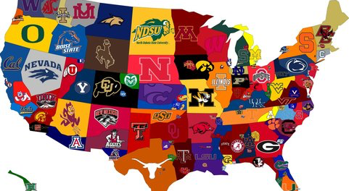
Athletic Sphere

Slide 6
Athletic Sphere
Student-athletes who first arrive at college display great enthusiasm for their sport according to a study done by Patricia Miller. They sought individual achievement and a feeling of satisfaction associated with training vigorously and competing well.
Throughout their university careers, the students implemented lifestyle changes as they complained of having little to no time for schoolwork and were often fatigued from athletics. As the athletics season intensified students fell behind on coursework and their grades began to suffer.

Slide 7
Athletic Sphere
When academics take priority, as it should according to the N.C.A.A, athletic achievement takes a backseat. Student-athletes regularly experience great stress in achieving their maximum potential in academics, athletics and their social life.
Due to society's encouragement of "academics comes first," student-athletes will often choose their academic and social spheres over their athletic sphere. This is primarily due to the fact that after college, nearly all student-athlete's athletic careers come to an end as they realize obtaining a professional career is highly improbable.

Slide 8
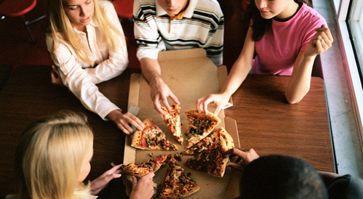
Social Sphere

Slide 9
Social Sphere
Student-athletes who first come to college already have a predetermined social group within their sports team. Often times this excludes them from expanding to other social circles among peers who are not involved in varsity athletics.
Student-athletes also compromise their social activities in exchange for athletic and academic commitment.
Due to the social restriction athletes face their social development can be altered or disrupted (Meyer).

Slide 10
Social Sphere
While not always true, student-athletes may feel that college athletics has inhibited their social development, leaving them with minor interests outside sport and a unidimensional perception of themselves.
Student-athletes who are dissatisfied with their peer interactions have a higher chance of doing poorly in academics.

Slide 11
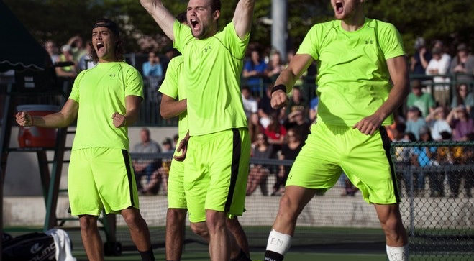
Emotional Life

Slide 12
Emotional Life
Student-athletes lead emotional lives in both the classroom and the field, whether or not they show it. Student-athletes are bound to experience the highs and lows that come with competing in both an academic and athletic setting.
A study conducted by Valiente et al. found that positive emotion such as joy, hope, and pride are positively correlated with a student's academic performance and overall achievement and vice versa. Therefore, if a student-athlete experiences negative emotion due to failure in sport and allows their mental state to carryover into the classroom their grades could suffer.

Slide 13
Emotional Life
Often times being part of a sports team can foster an individual's emotional well-being by providing a sense of belonging, support, and purpose.
There are, of course, both pros and cons to being a student-athlete and experiencing the emotional shifts that come with it. The manner in which a student-athlete deals with these emotions will determine both the outcome of their actions and the success they achieve on the field and in the classroom.

Slide 14
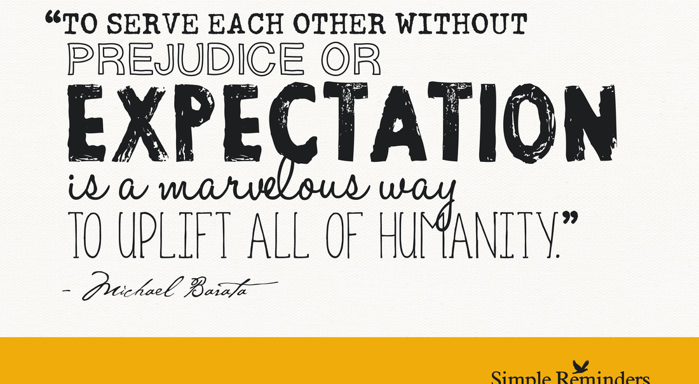
Societal Expectation

Slide 15
Societal Expectation
Student-athletes experience societal expectation when it comes to athletic and academic success. They feel the immense pressure involved in achieving "success" both on the field and in the classroom.
A study done by Jeffrey Lucas found that college athletes earn fewer bachelor's degrees, take longer to graduate, have lower grades, and undertake an easier curriculum.

Slide 16
Societal Expectation
There are also studies that support the social benefits of being involved on a sports team including the reduction of risky behavior and the enhancing of development in adolescents.
If student-athletes fail to balance their athletics and academics their emotional life is prone to negative consequences. Therefore, the societal expectation placed on student-athletes has a substantial impact on their well-being.

Slide 17

Professional Careers

Slide 18
Professional Careers
A majority of student-athletes are forced to give up their respective sports after college and enter corporate America. They are no longer defined by their athletic accomplishments, but rather their ability to perform in the workplace.
Often times, this is a drastic change for those who were once consumed by their physical activity. There is a shift in the former student-athletes emotional lives as they no longer experience the highs and lows on the field or court, but rather in the office. This adaptation can be too difficult for some resulting in alternate career paths such as becoming a coach of their respective sports.

Slide 19
Findings

Slide 20
Findings

Slide 21
Findings

Slide 22
Findings
Seven out of the ten interviewed student-athletes said that being part of a sports team had a positive impact on their social life.
When asked what sphere suffers the most the majority of student-athletes responded that the academic sphere does.
When asked what (if any) negative impacts does being a student-athlete have on an individual the three most commonly cited reasons were a lack of time, stress, and a worsened social life.

